Slide 1

Title: Predicting Hospital Utilization - A Generalized Linear Model Approach
Shinjon Ghosh
Graduate Student
Department of Mathematics

Slide 2
Introduction
Hospital utilization is a critical aspect of healthcare management.
Understanding the factors influencing hospital visits can help policymakers, healthcare providers, and insurance companies optimize resource allocation, improve patient care, and manage healthcare costs.

Slide 3
Dataset
A built-in R package (AER) dataset based on “Australian Health Service Utilization Data.”
The dataset has 12 variables & 5190 Observations.

Slide 4
Dataset
Variable | Description
Visits | Number of doctor visits in past 2 weeks
Gender | Factor indicating gender. "male" -> 1, "female" -> 2
Age | Age in years
Income | Annual income in tens of thousands of dollars
Illness | Number of illnesses in past 2 weeks
Reduced | Number of days of reduced activity in past 2 weeks due to illness or injury
Health | General health questionnaire score using Goldberg's method
Private | Indicator of private health insurance (factor: "yes" = 2 or "no" = 1)
Freepoor | Indicator for eligibility for free government healthcare (factor: "yes" = 2 or "no" = 1)
Freerepat | individual have free government health insurance due to old age, disability or veteran status (factor: “yes” = 2 or “no” = 1)
nchronic | chronic condition not limiting activity (factor: “yes” = 2 or “no” = 1
lchronic | Chronic condition limiting activity (factor: “yes” = 2 or “no” = 1)

Slide 5
Goldberg’s Scoring Method (0-0-1-1 Method)
• Low Scores (0-4): Likely to be in good health.
• Moderate Scores (5-9): Possible mild health issues.
• High Scores (10+): Suggestive significant health issues.
Response | Score
Not at all | 0
No more than usual | 0
Rather more than usual | 1
Much more than usual | 1

Slide 6
Dataset
No missing values.
I use the factor function for factorizing Gender, Private, Freepoor, Freerepat, nchronic, and lchronic variables.
Splitting the dataset.
The training set (80% = 4152 observations) is used to build and learn the patterns in the data.
The testing set (20% = 1038 observations) is used to evaluate the model's performance on unseen data.

Slide 7
Goal
• Fit and compare GLMs & Machine Learning models to predict hospital visits.
1
• Identification of significant predictors and their impact on hospital utilization.
2
• Interpret model results to offer policy recommendations for improving healthcare accessibility.
3

Slide 8
Main Challenges
Find out important interaction variables.
Train the machine learning models.

Slide 9
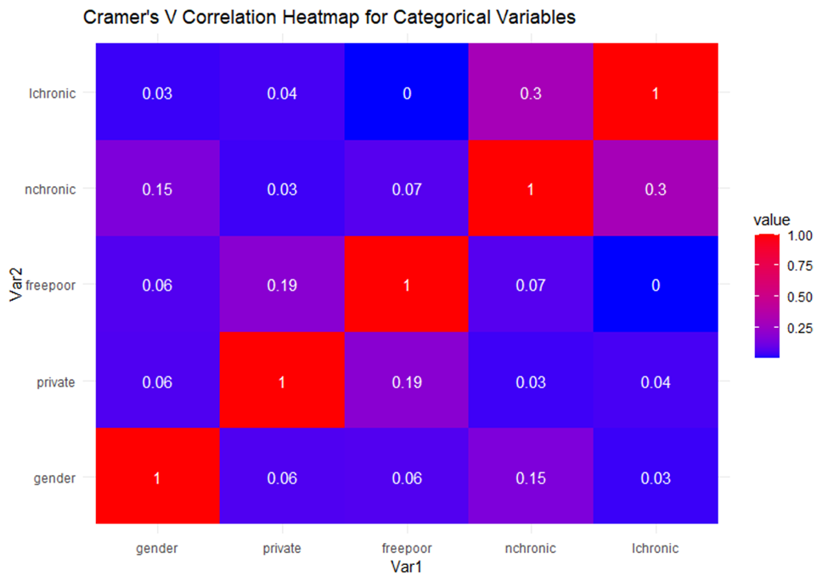
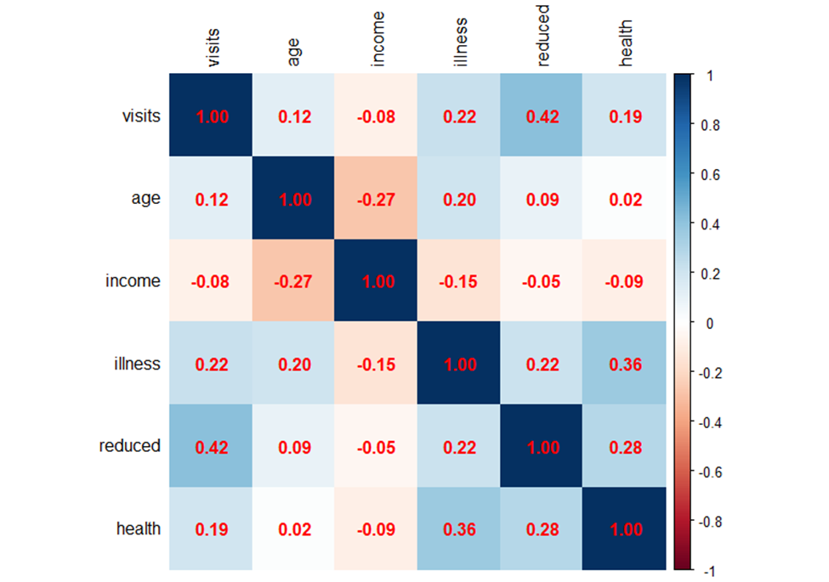
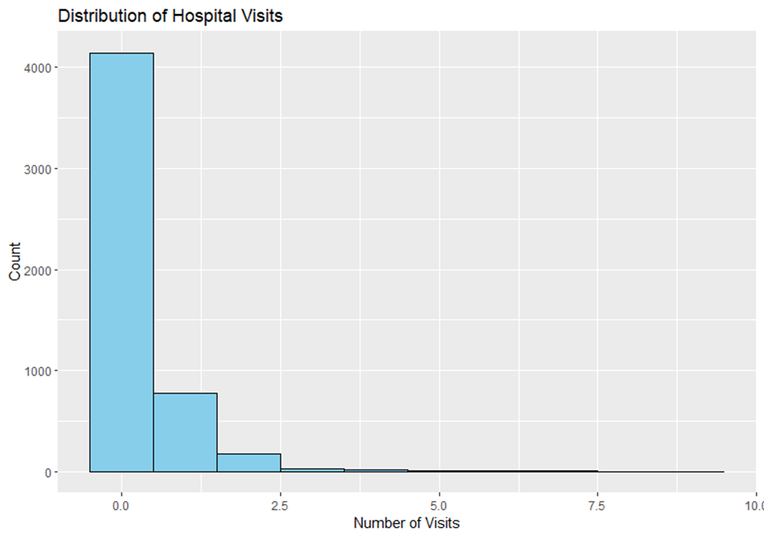
EDA

Slide 10
GLMs – Poisson Regression
log (𝐸(𝑦𝑖)) = log(𝜇𝑖) = 𝛽0 + 𝛽1𝑋𝑖1 + ⋯ + 𝛽𝑝𝑋𝑖𝑝
Model 1 (Full Model) : glm(formula = visits ~ . , family = poisson(link = "log"), data = train_data)
Model 2 (Reduced model): glm(formula = visits ~ gender + illness + reduced + health + freepoor + lchronic, family = poisson(link = "log"), data = train_data)
Model 3 (Interaction Variables Model) : glm(formula = visits ~ age * gender + income * private + illness + reduced + health + freepoor + nchronic + lchronic, family = poisson(link = "log"), data = train_data)

Slide 11
GLMs – Poisson Regression
Model – 4 (Forward Model) : glm(formula = visits ~ reduced + illness + age + health + gender + freepoor, family = poisson(link = “log”), data = train_data)
Model – 5 (Backward Model) : glm(formula = visits ~ gender + income + illness + reduced + health + private + freepoor + freerepat + nchronic + lchronic, family = poisson(link = “log”), data = train_data)
Model – 6 (Step-wise Model) : glm(formula = visits ~ gender + income + illness + reduced + health + private + freepoor + freerepat + nchronic + lchronic, family = poisson(link = “log”), data = train_data)
Model – 7 (Higher order with interaction variable model) : glm(formula = visits ~ age^2 + gender + income^2 * private^3 + illness + reduced + health + freepoor + nchronic^2 + lchronic, family = poisson(link = “log”), data = train_data)

Slide 12
Goodness of Fit Measures – AIC , BIC & Deviance
Model | Fitted Model in Details | AIC | Deviance | BIC
Model – 1 (Full Model) | glm(formula = visits ~ . , family = poisson(link = “log”), data = train_data) | 5324.2 | 3432.3 | 5400.164
Model – 2 (Reduced Model) | glm(formula = visits ~ gender + illness + reduced + health + freepoor + lchronic, family = poisson(link = “log”), data = train_data) | 5336 | 3454.1 | 5380.278
Model – 3 (Interaction Variables Model) | glm(formula = visits ~ age * gender + income * private + illness + reduced + health + freepoor + nchronic + lchronic, family = poisson(link = “log”), data = train_data) | 5309.9 | 3416 | 5392.191
Model – 4 (Forward Model) | glm(formula = visits ~ reduced + illness + age + health + gender + freepoor, family = poisson(link = “log”), data = train_data) | 5325.4 | 3443.6 | 5331.3
Model – 5 (Backward Model) | glm(formula = visits ~ gender + income + illness + reduced + health + private + freepoor + freerepat + nchronic + lchronic, family = poisson(link = “log”), data = train_data) | 5323.8 | 3434 | 5329.8
Model – 6 (Step-wise Model) | glm(formula = visits ~ gender + income + illness + reduced + health + private + freepoor + freerepat + nchronic + lchronic, family = poisson(link = “log”), data = train_data) | 5323.8 | 3434 | 5329.8
Model – 7 (Higher order with Interaction variables model) | glm(formula = visits ~ age^2 + gender + income^2 * private^3 + illness + reduced + health + freepoor + nchronic^2 + lchronic, family = poisson(link = “log”), data = train_data) | 5316.6 | 3424.7 | 5392.541

Slide 13
Likelihood-Ratio Test

Slide 14

Dispersion Ratio
For a Poisson-distributed random variable Y:
Mean: E(Y)=μ
Variance: Var(Y)=μ
If the variance is greater than the mean (Var(Y)>μ), the data is overdispersed.
If the variance is less than the mean (Var(Y)<μ), the data is underdispersed.
The dispersion ratio (D) is defined as:
$D=\frac{Ovserved Variance}{Ovserved Mean}$
Dispersion Ratio | 1.272289

Slide 15
GLMs – Negative Binomial Regression
glm.nb(visits ~ age * gender + income*private + illness + reduced + health + freepoor +nchronic + lchronic, data = train_data)
Dispersion Ratio | 0.9920598
Model | AIC | Deviance | McFadden’s Pseudo R-Squared | p-value
Negative Binomial | 5110.5 | 2460.5 | 100% | 1.000

Slide 16
GLMs – Negative Binomial Regression
Predictors | Estimate | p-value
Age | 1.898243 | 0.001800
GenderFemale | 0.616668 | 0.000293
Income | -1.182246 | 0.001713
PrivateYes | -0.307022 | 0.025958
Illness | 0.188026 | 4.87e-13
Reduced | 0.140732 | < 2e-16
Health | 0.046821 | 0.001558
FreepoorYes | -0.651108 | 0.005449
nchronicyes | 0.132838 | 0.126492
lchronicyes | 0.193847 | 0.086889
Age : GenderFemale | -0.922826 | 0.008926
Income : PrivateYes | 0.644924 | 0.003068

Slide 17
Model Prediction – Negative Binomial & Random Forest
Model | RMSE |  | MAE
 | Train | Test | Train | Test
Negative Binomial | 0.7395115 | 0.8504019 | 0.4163303 | 0.4458986
Random Forest | 0.4694575 | 0.8315878 | 0.2753708 | 0.4297475

Slide 18
Results & Discussions
According to the Likelihhod Ratio test, we can say that the interaction terms have a significant impact on the response variable.
Significant Predictors: Age, GenderFemale, Income, PrivateYes, Illness, Reduced, Health, FreepoorYes, Age : GenderFemale, Income : PrivateYes.
Not Significant Predictors: nchronic, lchronic
Age, female gender, reduced activity, and more illnesses increase doctor visits.
Higher income and private insurance reduce visits, but when combined, they increase visits.
Being "free poor" significantly decreases visits.
The effect of age on visits is lower for females.

Slide 19
Limitations
The dataset is from 1978 to 1979.
Outdated Healthcare System
Policy recommendations based on this data might be misleading

Slide 20

Any Questions???

